Slide 1
ECE 532
CHAPTER 5: SEARCH AND SORTING (PART 2: QUADRATIC SORTING - SELECTION, INSERTION, AND BUBBLE SORTS)
Lecturer: Dr. Roslina Mohamad
Room: Tower 2, Level 13, No:14C

Slide 2
Learning Outcomes
In this chapter, you will:
Learn the various quadratic sorting algorithms
Implement selection, insertion and bubble sorting algorithms
Compare sorting algorithm performance

Slide 3
Introduction
The problem:
Given an array a[0], a[1], … a[n-1],
reorder entries so that
a[0] <= a[1] <= … <= a[n-1]
Before:
4 5 2 6 12 3 5 1
After:
1 2 3 4 5 5 6 12
An extremely common operation

Slide 4
The Structure of the data
In practice, the values to be sorted is usually part of a collection of data called a record
Each record contains a key, which is the value to be sorted, and the remainder of the record consists of satellite data
We must usually move not only the key but the satellite data also
If there is a large amount of satellite data we sometimes sort an array of pointer (or indices) to the records rather than the records themselves

Slide 5
Selection Sort
There are a number of ways of sorting a list of N numbers
The first we will look at is called the Selection Sort algorithm
The algorithm can be stated as follows :
Find the smallest element of A and swap it with the element in the first position of A
Find the next smallest element in A and swap it with the element in the second position of A
Continue until A is sorted

Slide 6
Selection Sort: Array-Based Lists
Selection sort algorithm: rearrange list by selecting an element and moving it to its proper position
Find the smallest (or largest) element and move it to the beginning (end) of the list
Can also be applied to linked lists

Slide 7
Sorting an Array of Integers
The picture shows an array of six integers that we want to sort from smallest to largest
[0] [1] [2] [3] [4] [5]
Notes:
The picture shows a graphical representation of an array which we will sort so that the smallest element ends up at the front, and the other elements increase to the largest at the end. The bar graph indicates the values which are in the array before sorting--for example the first element of the array contains the integer 45.

Slide 8
The Selectionsort Algorithm
Start by finding the smallest entry.
[0] [1] [2] [3] [4] [5]
Notes:
The first sorting algorithm that we'll examine is called Selectionsort. It begins by going through the entire array and finding the smallest element. In this example, the smallest element is the number 8 at location [4] of the array.

Slide 9
The Selectionsort Algorithm
Start by finding the smallest entry.
Swap the smallest entry with the first entry.
[0] [1] [2] [3] [4] [5]
Notes:
Once we have found the smallest element, that element is swapped with the first element of the array...

Slide 10
The Selectionsort Algorithm
Start by finding the smallest entry.
Swap the smallest entry with the first entry.
[0] [1] [2] [3] [4] [5]
Notes:
...like this.
The smallest element is now at the front of the array, and we have taken one small step toward producing a sorted array.

Slide 11
The Selectionsort Algorithm
Sorted side
Unsorted side
Part of the array is now sorted.
[0] [1] [2] [3] [4] [5]
Notes:
At this point, we can view the array as being split into two sides: To the left of the dotted line is the "sorted side", and to the right of the dotted line is the "unsorted side". Our goal is to push the dotted line forward, increasing the number of elements in the sorted side, until the entire array is sorted.

Slide 12
The Selectionsort Algorithm
Sorted side
Unsorted side
Find the smallest element in the unsorted side.
[0] [1] [2] [3] [4] [5]
Notes:
Each step of the Selectionsort works by finding the smallest element in the unsorted side. At this point, we would find the number 15 at location [5] in the unsorted side.

Slide 13
The Selectionsort Algorithm
Sorted side
Unsorted side
Find the smallest element in the unsorted side.
Swap with the front of the unsorted side.
[0] [1] [2] [3] [4] [5]
Notes:
This small element is swapped with the number at the front of the unsorted side, as shown here...

Slide 14
The Selectionsort Algorithm
Sorted side
Unsorted side
We have increased the size of the sorted side by one element.
[0] [1] [2] [3] [4] [5]
Notes:
...and the effect is to increase the size of the sorted side by one element.
As you can see, the sorted side always contains the smallest numbers, and those numbers are sorted from small to large. The unsorted side contains the rest of the numbers, and those numbers are in no particular order.

Slide 15
The Selectionsort Algorithm
Sorted side
Unsorted side
Smallest
from
unsorted
The process continues...
[0] [1] [2] [3] [4] [5]
Notes:
Again, we find the smallest entry in the unsorted side...

Slide 16
The Selectionsort Algorithm
Sorted side
Unsorted side
The process continues...
Swap
with
front
[0] [1] [2] [3] [4] [5]
Notes:
...and swap this element with the front of the unsorted side.

Slide 17
The Selectionsort Algorithm
Sorted side
is bigger
Sorted side
Unsorted side
The process continues...
[0] [1] [2] [3] [4] [5]
Notes:
The sorted side now contains the three smallest elements of the array.

Slide 18
The Selectionsort Algorithm
The process keeps adding one more number to the sorted side.
The sorted side has the smallest numbers, arranged from small to large.
Sorted side
Unsorted side
[0] [1] [2] [3] [4] [5]
Notes:
Here is the array after increasing the sorted side to four elements.

Slide 19
The Selectionsort Algorithm
We can stop when the unsorted side has just one number, since that number must be the largest number.
Sorted side
Unsorted side
[0] [1] [2] [3] [4] [5]
Notes:
And now the sorted side has five elements.
In fact, once the unsorted side is down to a single element, the sort is completed. At this point the 5 smallest elements are in the sorted side, and so the the one largest element is left in the unsorted side.
We are done...

Slide 20
The Selectionsort Algorithm
The array is now sorted.
We repeatedly selected the smallest element, and moved this element to the front of the unsorted side.
[0] [1] [2] [3] [4] [5]
Notes:
...The array is sorted.
The basic algorithm is easy to state and also easy to program.

Slide 21
Selection Sort Algorithm
Selection-Sort(A)
for i = 0 to length(A) –2
smallestplace = i
for j = i+1 to length(A) - 1
if A[j] < A[smallestplace] then
smallestplace = j
endif
endfor
swap(A[i], A[smallestplace])
endfor
endalg

Slide 22
Example 1
0 | 1 | 2 | 3 | 4 | 5
9 | 8 | 7 | 6 | 5 | 4
A =
After first run through loop
0 | 1 | 2 | 3 | 4 | 5
4 | 8 | 7 | 6 | 5 | 9
A =
After second run through loop
0 | 1 | 2 | 3 | 4 | 5
4 | 5 | 7 | 6 | 8 | 9
A =

Slide 23
Example 1
After third run through loop
0 | 1 | 2 | 3 | 4 | 5
4 | 5 | 6 | 7 | 8 | 9
A =
0 | 1 | 2 | 3 | 4 | 5
4 | 5 | 6 | 7 | 8 | 9
A =
0 | 1 | 2 | 3 | 4 | 5
4 | 5 | 6 | 7 | 8 | 9
A =

Slide 24
Example 2
A
0 | 1 | 2 | 3 | 4
56 | 43 | 78 | 12 | 23
1
0 | 1 | 2 | 3 | 4
12 | 43 | 78 | 56 | 23
0 | 1 | 2 | 3 | 4
12 | 23 | 43 | 56 | 78
3
0 | 1 | 2 | 3 | 4
12 | 23 | 78 | 56 | 43
0 | 1 | 2 | 3 | 4
12 | 23 | 43 | 56 | 78
2
4

Slide 25
Example 5.4, Example 5.5

Slide 26




Analysis: Selection Sort
function swap: does three assignments; executed n−1 times
3(n − 1) = O(n)
function minLocation:
For a list of length k, k−1 key comparisons
Executed n−1 times (by selectionSort)
Number of key comparisons:

Slide 27
Discussion
Selection sort is a common sense algorithm
It is efficient only for small amounts of data
We must loop through every unsorted element each time
This double loop structure can be inefficient for large data sets
Also, the algorithm has no way of recognising when the data set is sorted
This can make it inefficient for partially sorted data

Slide 28
Insertion Sort
Insertion sort, sometimes known as linear insertion sort, works the way many people sort a hand of playing cards
We start with an empty left hand and the cards face down on the table
We then remove one card at a time from the table and insert it into the correct position in the left hand
To find the correct position for a card, we compare it with each of the cards already in the hand, from right to left
Insert the card

Slide 29
The Insertionsort Algorithm
The Insertionsort algorithm also views the array as having a sorted side and an unsorted side.
[0] [1] [2] [3] [4] [5]
Notes:
Now we'll look at another sorting method called Insertionsort. The end result will be the same: The array will be sorted from smallest to largest. But the sorting method is different.
However, there are some common features. As with the Selectionsort, the Insertionsort algorithm also views the array as having a sorted side and an unsorted side, ...

Slide 30
The Insertionsort Algorithm
Sorted side
Unsorted side
The sorted side starts with just the first element, which is not necessarily the smallest element.
[0] [1] [2] [3] [4] [5]
Notes:
...like this.
However, in the Selectionsort, the sorted side always contained the smallest elements of the array. In the Insertionsort, the sorted side will be sorted from small to large, but the elements in the sorted side will not necessarily be the smallest entries of the array.
Because the sorted side does not need to have the smallest entries, we can start by placing one element in the sorted side--we don't need to worry about sorting just one element. But we do need to worry about how to increase the number of elements that are in the sorted side.

Slide 31
The Insertionsort Algorithm
Sorted side
Unsorted side
The sorted side grows by taking the front element from the unsorted side...
[0] [1] [2] [3] [4] [5]
Notes:
The basic approach is to take the front element from the unsorted side...

Slide 32
The Insertionsort Algorithm
Sorted side
Unsorted side
...and inserting it in the place that keeps the sorted side arranged from small to large.
[0] [1] [2] [3] [4] [5]
Notes:
...and insert this element at the correct spot of the sorted side.
In this example, the front element of the unsorted side is 20. So the 20 must be inserted before the number 45 which is already in the sorted side.

Slide 33
The Insertionsort Algorithm
Sorted side
Unsorted side
In this example, the new element goes in front of the element that was already in the sorted side.
[0] [1] [2] [3] [4] [5]
Notes:
After the insertion, the sorted side contains two elements. These two elements are in order from small to large, although they are not the smallest elements in the array.

Slide 34
The Insertionsort Algorithm
Sorted side
Unsorted side
Sometimes we are lucky and the new inserted item doesn't need to move at all.
[0] [1] [2] [3] [4] [5]
Notes:
Sometimes we are lucky and the newly inserted element is already in the right spot. This happens if the new element is larger than anything that's already in the array.

Slide 35
The Insertionsort Algorithm
Sorted side
Unsorted side
Sometimes we are lucky twice in a row.
[0] [1] [2] [3] [4] [5]
Notes:
Sometimes we are lucky twice in a row.

Slide 36
How to Insert One Element
Copy the new element to a separate location.
Sorted side
Unsorted side
[0] [1] [2] [3] [4] [5]
Notes:
The actual insertion process requires a bit of work that is shown here. The first step of the insertion is to make a copy of the new element. Usually this copy is stored in a local variable. It just sits off to the side, ready for us to use whenever we need it.

Slide 37
How to Insert One Element
Shift elements in the sorted side, creating an open space for the new element.
[0] [1] [2] [3] [4] [5]
Notes:
After we have safely made a copy of the new element, we start shifting elements from the end of the sorted side. These elements are shifted rightward, to create an "empty spot" for our new element to be placed.
In this example we take the last element of the sorted side and shift it rightward one spot...

Slide 38
How to Insert One Element
Shift elements in the sorted side, creating an open space for the new element.
[0] [1] [2] [3] [4] [5]
Notes:
...like this.
Is this the correct spot for the new element? No, because the new element is smaller than the next element in the sorted section. So we continue shifting elements rightward...

Slide 39
How to Insert One Element
Continue shifting elements...
[0] [1] [2] [3] [4] [5]
Notes:
This is still not the correct spot for our new element, so we shift again...

Slide 40
How to Insert One Element
Continue shifting elements...
[0] [1] [2] [3] [4] [5]
Notes:
...and shift one more time...

Slide 41
How to Insert One Element
...until you reach the location for the new element.
[0] [1] [2] [3] [4] [5]
Notes:
Finally, this is the correct location for the new element. In general there are two situations that indicate the "correct location" has been found:
1. We reach the front of the array (as happened here), or
2. We reached an element that is less than or equal to the new element.

Slide 42
How to Insert One Element
Copy the new element back into the array, at the correct location.
Sorted side
Unsorted side
[0] [1] [2] [3] [4] [5]
Notes:
Once the correct spot is found, we copy the new element back into the array. The number of elements in the sorted side has increased by one.

Slide 43
How to Insert One Element
The last element must also be inserted. Start by copying it...
Sorted side
Unsorted side
[0] [1] [2] [3] [4] [5]
Notes:
The last element of the array also needs to be inserted. Start by copying it to a safe location.

Slide 44
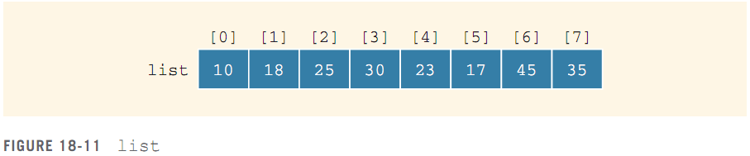
Insertion Sort: Array-Based Lists
Insertion sort algorithm: sorts the list by moving each element to its proper place in the sorted portion of the list

Slide 45
Insertion Sort Algorithm
Insertion-Sort(A)
for j = 1 to length[A] - 1
temp = A[j]
i = j – 1
while i >= 0 and A[i] > temp
A[i+1] = A[i]
i = i – 1
endwhile
A[i+1] = temp
endfor
endalg

Slide 46
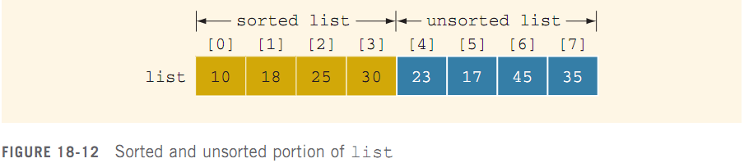
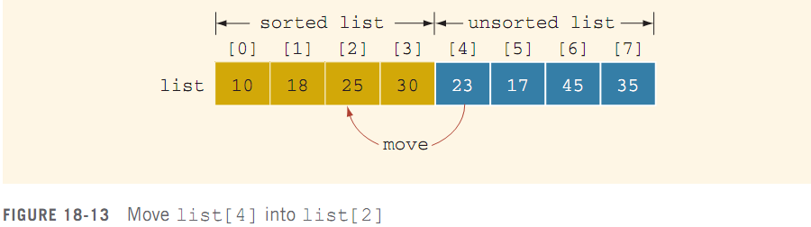
Insertion Sort: Array-Based Lists

Slide 47
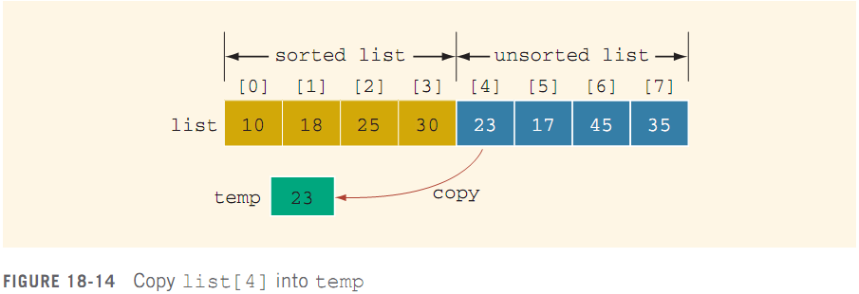
Insertion Sort: Array-Based Lists

Slide 48
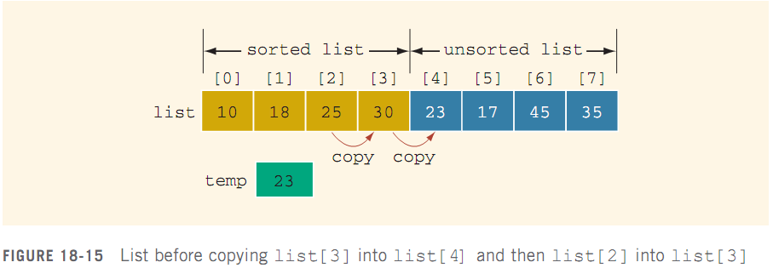
Insertion Sort: Array-Based Lists

Slide 49
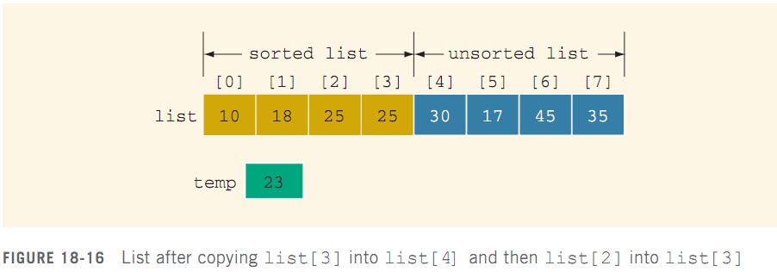
Insertion Sort: Array-Based Lists

Slide 50
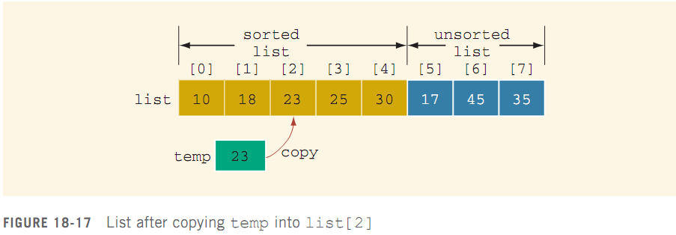
Insertion Sort: Array-Based Lists

Slide 51
Insertion Sort Algorithm
Store a[j] in a temporary variable temp
Shift all elements > temp to the right by one slot
Insert temp in the “hole” created
1
2
3
A
1 4 5 8 9 6
A
1 4 5 8 9
A
1 4 5 6 8 9
temp
6
temp
6
temp
6

Slide 52
Insertion Sort
During the process of insertion sort, the array is divided into a sorted section and an unsorted section – the sorted section grows and the unsorted section shrinks.
3
18
19
22
17
16
6
1
15
2
sorted section
unsorted section

Slide 53
Insertion Sort (cont.)
next value to be inserted into sorted section
3
18
19
22
17
16
6
1
15
2
sorted section
unsorted section

Slide 54
Insertion Sort (cont.)
3
18
19
22
17
16
6
1
15
2
sorted section
unsorted section

Slide 55
Insertion Sort (cont.)
17
3
18
19
22
16
6
1
15
2
sorted section
unsorted section

Slide 56
Insertion Sort (cont.)
17
3
18
19
22
16
6
1
15
2
sorted section
unsorted section

Slide 57
Insertion Sort (cont.)
3
17
18
19
22
16
6
1
15
2
sorted section
unsorted section

Slide 58
Insertion Sort (cont.)
3
17
18
19
22
16
6
1
15
2
sorted section
unsorted section

Slide 59
Insertion Sort (cont.)
On each iteration of insertion sort, the sorted section grows by 1, and the unsorted section shrinks by 1, until the array is sorted.
3
17
18
19
22
16
6
1
15
2
sorted section
unsorted section

Slide 60
Insertion Sort (cont.)
16 would be the next value to be “inserted”, giving insertion sort its name
3
17
18
19
22
16
6
1
15
2
sorted section
unsorted section

Slide 61
Insertion Sort (cont.)
1 for each j, from 1 to the length of A – 1
2 i = j – 1
3 while i is greater than -1 and A[ i ] is greater than A[ i + 1 ]
4 swap( A[ i ], A[ i + 1 ] )
5 i--
In the algorithm, j is used to mark the index of the next element to be inserted.
3
17
18
19
22
16
6
1
15
2
sorted section
unsorted section

Slide 62
Insertion Sort (cont.)
1 for each j, from 1 to the length of A – 1
2 i = j – 1
3 while i is greater than -1 and A[ i ] is greater than A[ i + 1 ]
4 swap( A[ i ], A[ i + 1 ] )
5 i--
j
0 1 2 3 4 5 6 7 8 9
3
17
18
19
22
16
6
1
15
2
sorted section
unsorted section

Slide 63
Insertion Sort (cont.)
1 for each j, from 1 to the length of A – 1
2 i = j – 1
3 while i is greater than -1 and A[ i ] is greater than A[ i + 1 ]
4 swap( A[ i ], A[ i + 1 ] )
5 i--
j
0 1 2 3 4 5 6 7 8 9
3
17
18
19
22
16
6
1
15
2
sorted section
unsorted section

Slide 64
Insertion Sort (cont.)
1 for each j, from 1 to the length of A – 1
2 i = j – 1
3 while i is greater than -1 and A[ i ] is greater than A[ i + 1 ]
4 swap( A[ i ], A[ i + 1 ] )
5 i--
i
j
0 1 2 3 4 5 6 7 8 9
3
17
18
19
22
16
6
1
15
2
sorted section
unsorted section

Slide 65
Insertion Sort (cont.)
1 for each j, from 1 to the length of A – 1
2 i = j – 1
3 while i is greater than -1 and A[ i ] is greater than A[ i + 1 ]
4 swap( A[ i ], A[ i + 1 ] )
5 i--
i
j
0 1 2 3 4 5 6 7 8 9
3
17
18
19
22
16
6
1
15
2
sorted section
unsorted section

Slide 66
Insertion Sort (cont.)
1 for each j, from 1 to the length of A – 1
2 i = j – 1
3 while i is greater than -1 and A[ i ] is greater than A[ i + 1 ]
4 swap( A[ i ], A[ i + 1 ] )
5 i--
i
j
0 1 2 3 4 5 6 7 8 9
3
17
18
19
22
16
6
1
15
2
sorted section
unsorted section

Slide 67
Insertion Sort (cont.)
1 for each j, from 1 to the length of A – 1
2 i = j – 1
3 while i is greater than -1 and A[ i ] is greater than A[ i + 1 ]
4 swap( A[ i ], A[ i + 1 ] )
5 i--
i
j
0 1 2 3 4 5 6 7 8 9
16
3
17
18
19
22
6
1
15
2
sorted section
unsorted section

Slide 68
Insertion Sort (cont.)
1 for each j, from 1 to the length of A – 1
2 i = j – 1
3 while i is greater than -1 and A[ i ] is greater than A[ i + 1 ]
4 swap( A[ i ], A[ i + 1 ] )
5 i--
i
j
0 1 2 3 4 5 6 7 8 9
16
3
17
18
19
22
6
1
15
2
sorted section
unsorted section

Slide 69
Insertion Sort (cont.)
1 for each j, from 1 to the length of A – 1
2 i = j – 1
3 while i is greater than -1 and A[ i ] is greater than A[ i + 1 ]
4 swap( A[ i ], A[ i + 1 ] )
5 i--
i
j
0 1 2 3 4 5 6 7 8 9
3
17
18
19
16
22
6
1
15
2
sorted section
unsorted section

Slide 70
Insertion Sort (cont.)
1 for each j, from 1 to the length of A – 1
2 i = j – 1
3 while i is greater than -1 and A[ i ] is greater than A[ i + 1 ]
4 swap( A[ i ], A[ i + 1 ] )
5 i--
i
j
0 1 2 3 4 5 6 7 8 9
3
17
18
19
16
22
6
1
15
2
sorted section
unsorted section

Slide 71
Insertion Sort (cont.)
1 for each j, from 1 to the length of A – 1
2 i = j – 1
3 while i is greater than -1 and A[ i ] is greater than A[ i + 1 ]
4 swap( A[ i ], A[ i + 1 ] )
5 i--
i
j
0 1 2 3 4 5 6 7 8 9
3
17
18
19
16
22
6
1
15
2
sorted section
unsorted section

Slide 72
Insertion Sort (cont.)
1 for each j, from 1 to the length of A – 1
2 i = j – 1
3 while i is greater than -1 and A[ i ] is greater than A[ i + 1 ]
4 swap( A[ i ], A[ i + 1 ] )
5 i--
i
j
0 1 2 3 4 5 6 7 8 9
3
17
18
19
16
22
6
1
15
2
sorted section
unsorted section

Slide 73
Insertion Sort (cont.)
1 for each j, from 1 to the length of A – 1
2 i = j – 1
3 while i is greater than -1 and A[ i ] is greater than A[ i + 1 ]
4 swap( A[ i ], A[ i + 1 ] )
5 i--
i
j
0 1 2 3 4 5 6 7 8 9
3
17
18
19
16
22
6
1
15
2
sorted section
unsorted section

Slide 74
Insertion Sort (cont.)
1 for each j, from 1 to the length of A – 1
2 i = j – 1
3 while i is greater than -1 and A[ i ] is greater than A[ i + 1 ]
4 swap( A[ i ], A[ i + 1 ] )
5 i--
i
j
0 1 2 3 4 5 6 7 8 9
16
3
17
18
22
6
1
15
2
19
sorted section
unsorted section

Slide 75
Insertion Sort (cont.)
1 for each j, from 1 to the length of A – 1
2 i = j – 1
3 while i is greater than -1 and A[ i ] is greater than A[ i + 1 ]
4 swap( A[ i ], A[ i + 1 ] )
5 i--
i
j
0 1 2 3 4 5 6 7 8 9
16
3
17
18
22
6
1
15
2
19
sorted section
unsorted section

Slide 76
Insertion Sort (cont.)
1 for each j, from 1 to the length of A – 1
2 i = j – 1
3 while i is greater than -1 and A[ i ] is greater than A[ i + 1 ]
4 swap( A[ i ], A[ i + 1 ] )
5 i--
i
j
0 1 2 3 4 5 6 7 8 9
3
17
18
16
19
22
6
1
15
2
sorted section
unsorted section

Slide 77
Insertion Sort (cont.)
1 for each j, from 1 to the length of A – 1
2 i = j – 1
3 while i is greater than -1 and A[ i ] is greater than A[ i + 1 ]
4 swap( A[ i ], A[ i + 1 ] )
5 i--
i
j
0 1 2 3 4 5 6 7 8 9
3
17
18
16
19
22
6
1
15
2
sorted section
unsorted section

Slide 78
Insertion Sort (cont.)
1 for each j, from 1 to the length of A – 1
2 i = j – 1
3 while i is greater than -1 and A[ i ] is greater than A[ i + 1 ]
4 swap( A[ i ], A[ i + 1 ] )
5 i--
i
j
0 1 2 3 4 5 6 7 8 9
3
17
18
16
19
22
6
1
15
2
sorted section
unsorted section

Slide 79
Insertion Sort (cont.)
1 for each j, from 1 to the length of A – 1
2 i = j – 1
3 while i is greater than -1 and A[ i ] is greater than A[ i + 1 ]
4 swap( A[ i ], A[ i + 1 ] )
5 i--
i
j
0 1 2 3 4 5 6 7 8 9
3
17
18
16
19
22
6
1
15
2
sorted section
unsorted section

Slide 80
Insertion Sort (cont.)
1 for each j, from 1 to the length of A – 1
2 i = j – 1
3 while i is greater than -1 and A[ i ] is greater than A[ i + 1 ]
4 swap( A[ i ], A[ i + 1 ] )
5 i--
i
j
0 1 2 3 4 5 6 7 8 9
3
17
18
16
19
22
6
1
15
2
sorted section
unsorted section

Slide 81
Insertion Sort (cont.)
1 for each j, from 1 to the length of A – 1
2 i = j – 1
3 while i is greater than -1 and A[ i ] is greater than A[ i + 1 ]
4 swap( A[ i ], A[ i + 1 ] )
5 i--
i
j
0 1 2 3 4 5 6 7 8 9
16
3
17
19
22
6
1
15
2
18
sorted section
unsorted section

Slide 82
Insertion Sort (cont.)
1 for each j, from 1 to the length of A – 1
2 i = j – 1
3 while i is greater than -1 and A[ i ] is greater than A[ i + 1 ]
4 swap( A[ i ], A[ i + 1 ] )
5 i--
i
j
0 1 2 3 4 5 6 7 8 9
16
3
17
19
22
6
1
15
2
18
sorted section
unsorted section

Slide 83
Insertion Sort (cont.)
1 for each j, from 1 to the length of A – 1
2 i = j – 1
3 while i is greater than -1 and A[ i ] is greater than A[ i + 1 ]
4 swap( A[ i ], A[ i + 1 ] )
5 i--
i
j
0 1 2 3 4 5 6 7 8 9
3
17
16
18
19
22
6
1
15
2
sorted section
unsorted section

Slide 84
Insertion Sort (cont.)
1 for each j, from 1 to the length of A – 1
2 i = j – 1
3 while i is greater than -1 and A[ i ] is greater than A[ i + 1 ]
4 swap( A[ i ], A[ i + 1 ] )
5 i--
i
j
0 1 2 3 4 5 6 7 8 9
3
17
16
18
19
22
6
1
15
2
sorted section
unsorted section

Slide 85
Insertion Sort (cont.)
1 for each j, from 1 to the length of A – 1
2 i = j – 1
3 while i is greater than -1 and A[ i ] is greater than A[ i + 1 ]
4 swap( A[ i ], A[ i + 1 ] )
5 i--
i
j
0 1 2 3 4 5 6 7 8 9
3
17
16
18
19
22
6
1
15
2
sorted section
unsorted section

Slide 86
Insertion Sort (cont.)
1 for each j, from 1 to the length of A – 1
2 i = j – 1
3 while i is greater than -1 and A[ i ] is greater than A[ i + 1 ]
4 swap( A[ i ], A[ i + 1 ] )
5 i--
i
j
0 1 2 3 4 5 6 7 8 9
3
17
16
18
19
22
6
1
15
2
sorted section
unsorted section

Slide 87
Insertion Sort (cont.)
1 for each j, from 1 to the length of A – 1
2 i = j – 1
3 while i is greater than -1 and A[ i ] is greater than A[ i + 1 ]
4 swap( A[ i ], A[ i + 1 ] )
5 i--
i
j
0 1 2 3 4 5 6 7 8 9
3
17
16
18
19
22
6
1
15
2
sorted section
unsorted section

Slide 88
Insertion Sort (cont.)
1 for each j, from 1 to the length of A – 1
2 i = j – 1
3 while i is greater than -1 and A[ i ] is greater than A[ i + 1 ]
4 swap( A[ i ], A[ i + 1 ] )
5 i--
i
j
0 1 2 3 4 5 6 7 8 9
16
3
18
19
22
6
1
15
2
17
sorted section
unsorted section

Slide 89
Insertion Sort (cont.)
1 for each j, from 1 to the length of A – 1
2 i = j – 1
3 while i is greater than -1 and A[ i ] is greater than A[ i + 1 ]
4 swap( A[ i ], A[ i + 1 ] )
5 i--
i
j
0 1 2 3 4 5 6 7 8 9
16
3
18
19
22
6
1
15
2
17
sorted section
unsorted section

Slide 90
Insertion Sort (cont.)
1 for each j, from 1 to the length of A – 1
2 i = j – 1
3 while i is greater than -1 and A[ i ] is greater than A[ i + 1 ]
4 swap( A[ i ], A[ i + 1 ] )
5 i--
i
j
0 1 2 3 4 5 6 7 8 9
3
16
17
18
19
22
6
1
15
2
sorted section
unsorted section

Slide 91
Insertion Sort (cont.)
1 for each j, from 1 to the length of A – 1
2 i = j – 1
3 while i is greater than -1 and A[ i ] is greater than A[ i + 1 ]
4 swap( A[ i ], A[ i + 1 ] )
5 i--
i
j
0 1 2 3 4 5 6 7 8 9
3
16
17
18
19
22
6
1
15
2
sorted section
unsorted section

Slide 92
Insertion Sort (cont.)
1 for each j, from 1 to the length of A – 1
2 i = j – 1
3 while i is greater than -1 and A[ i ] is greater than A[ i + 1 ]
4 swap( A[ i ], A[ i + 1 ] )
5 i--
i
j
0 1 2 3 4 5 6 7 8 9
3
16
17
18
19
22
6
1
15
2
sorted section
unsorted section

Slide 93
Insertion Sort (cont.)
1 for each j, from 1 to the length of A – 1
2 i = j – 1
3 while i is greater than -1 and A[ i ] is greater than A[ i + 1 ]
4 swap( A[ i ], A[ i + 1 ] )
5 i--
i
j
0 1 2 3 4 5 6 7 8 9
3
16
17
18
19
22
6
1
15
2
sorted section
unsorted section

Slide 94
Insertion Sort (cont.)
1 for each j, from 1 to the length of A – 1
2 i = j – 1
3 while i is greater than -1 and A[ i ] is greater than A[ i + 1 ]
4 swap( A[ i ], A[ i + 1 ] )
5 i--
i
j
0 1 2 3 4 5 6 7 8 9
3
16
17
18
19
22
6
1
15
2
sorted section
unsorted section

Slide 95
Insertion Sort (cont.)
1 for each j, from 1 to the length of A – 1
2 i = j – 1
3 while i is greater than -1 and A[ i ] is greater than A[ i + 1 ]
4 swap( A[ i ], A[ i + 1 ] )
5 i--
i
j
0 1 2 3 4 5 6 7 8 9
3
16
17
18
19
22
6
1
15
2
sorted section
unsorted section

Slide 96
Insertion Sort (cont.)
1 for each j, from 1 to the length of A – 1
2 i = j – 1
3 while i is greater than -1 and A[ i ] is greater than A[ i + 1 ]
4 swap( A[ i ], A[ i + 1 ] )
5 i--
i
j
0 1 2 3 4 5 6 7 8 9
3
16
17
18
19
22
6
1
15
2
sorted section
unsorted section

Slide 97
Insertion Sort (cont.)
1 for each j, from 1 to the length of A – 1
2 i = j – 1
3 while i is greater than -1 and A[ i ] is greater than A[ i + 1 ]
4 swap( A[ i ], A[ i + 1 ] )
5 i--
i
j
0 1 2 3 4 5 6 7 8 9
3
16
17
18
19
22
6
1
15
2
sorted section
unsorted section

Slide 98
Insertion Sort (cont.)
1 for each j, from 1 to the length of A – 1
2 i = j – 1
3 while i is greater than -1 and A[ i ] is greater than A[ i + 1 ]
4 swap( A[ i ], A[ i + 1 ] )
5 i--
i
j
0 1 2 3 4 5 6 7 8 9
3
16
17
18
19
22
6
1
15
2
sorted section
unsorted section

Slide 99
Insertion Sort (cont.)
1 for each j, from 1 to the length of A – 1
2 i = j – 1
3 while i is greater than -1 and A[ i ] is greater than A[ i + 1 ]
4 swap( A[ i ], A[ i + 1 ] )
5 i--
etc.
i
j
0 1 2 3 4 5 6 7 8 9
3
16
17
18
19
22
6
1
15
2
sorted section
unsorted section

Slide 100
Example 5.6, Example 5.7

Slide 101
Analysis: Insertion Sort
The for loop executes n – 1 times
Best case (list is already sorted):
Key comparisons: n – 1 = O(n)
Worst case: for each for iteration, if statement evaluates to true
Key comparisons: 1 + 2 + … + (n – 1) = n(n – 1) / 2 = O(n²)
Average number of key comparisons and of item assignments: ¼ n² + O(n) = O(n²)

Slide 102
Discussion
This implementation starts from the front and moves the larger values towards the back
Each pass through the array places one item in its correct position within the sorted part of the array
Again you always do N-1 passes through the area – even if it is already sorted!
How could you modify it so that it recognises when the list is sorted?

Slide 103
Bubble Sort
Bubble sort works by comparing each adjacent pair of items in a list in turn, swapping the items if necessary, and repeating the pass through the list until no swaps are done.
It is sometimes called sinking sort or exchange sort
It can work from either the first item moving larger items towards the back of the list, or from the back moving smaller items towards the front
Performance can be improved by modifying it to a Bi-directional bubble sort, i.e. One pass from front to back, the next from back to front

Slide 104
Sorting a List: Bubble Sort
Suppose list[0]...list[n–1] is a list of n elements, indexed 0 to n–1
Bubble sort algorithm:
In a series of n-1 iterations, compare successive elements, list[index] and list[index+1]
If list[index] is greater than list[index+1], then swap them

Slide 105
Bubble Sort Example
Go along the list, compare 2 consecutive elements L[i]
and L[i+1].
Swap their value if L[i] > L[i+1].
0
3
1
6
2
5
3
12
4
17
5
8

Slide 106
Bubble Sort
Bubble-Sort( A)
for i = 0 to length(A)-1
for j = 0 to length(A) – 1
if A[j] > A[j+1] then
swap(A[j], A[j+1])
endif
endfor
endfor
endalg

Slide 107
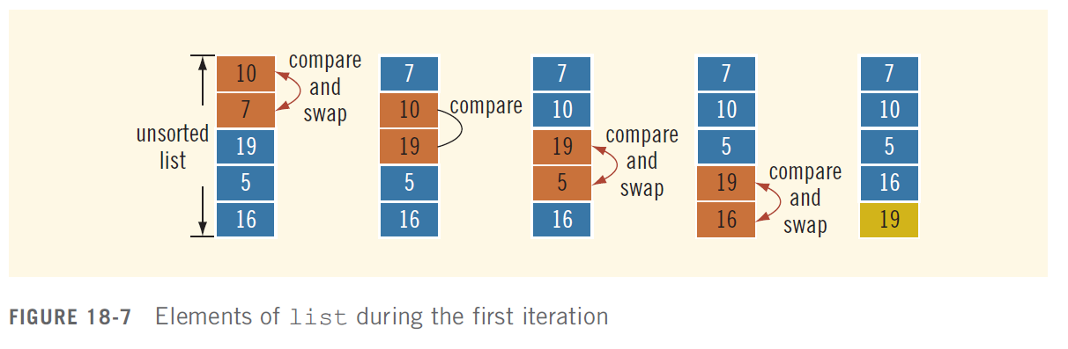
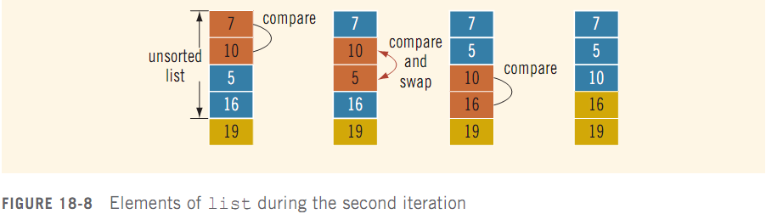
Sorting a List: Bubble Sort

Slide 108
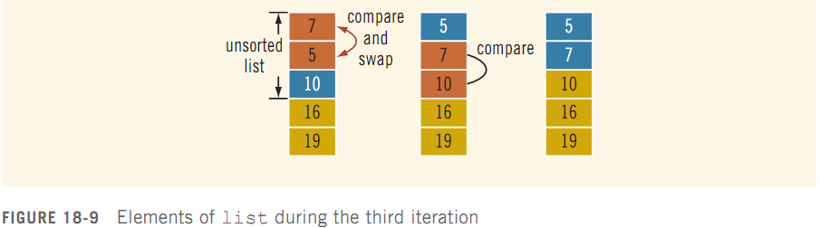
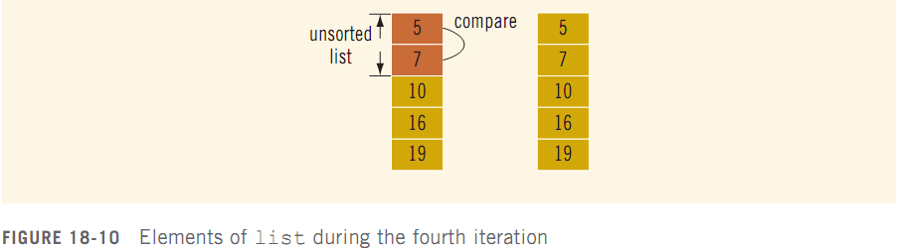
Sorting a List: Bubble Sort

Slide 109
Example 5.8, Example 5.9

Slide 110

Analysis: Bubble Sort
bubbleSort contains nested loops
Outer loop executes n – 1 times
For each iteration of outer loop, inner loop executes a certain number of times
Total number of comparisons:
Number of assignments (worst case):

Slide 111
Discussion
This implementation starts from the front and moves the larger values towards the back
Each pass through the array places one item in its correct position
You always do N-1 passes through the area – even if it is already sorted!
Why are there not N passes?
How could you modify it so that it recognises when the list is sorted?

Slide 112
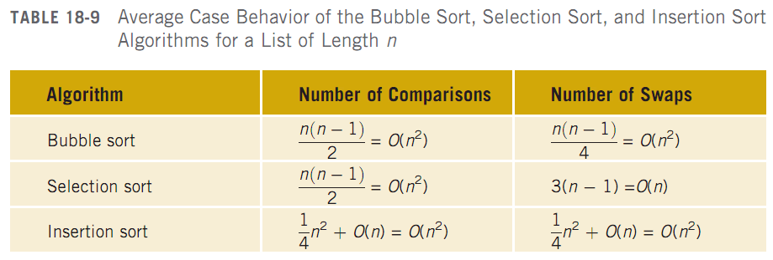
Analysis: Quadratic Sort

Slide 113
Summary
Sorting of data is a very common operation. We usually sort on one key, with satellite data attached to the key
Bubble Sort and Insertion Sort, along with Selection Sort sometimes known as the ‘simple’ sorts
Bubble Sort at each run through places one item in its correct position
Selection at each run through places one item in the correct position within the sorted part of the array
Insertion Sort maintains a sorted list by inserting the next item into its correct position at each run through
These algorithms do not do well with partially sorted data

Slide 114
https://en.wikipedia.org/wiki/Sorting_algorithm

